Slide 1
Introduction to Programming
Session 09
String in Java

Slide 2
Objectives
Java String.
Create a String object.
Methods of String.
Example.

Slide 3
Java String
String is a sequence of characters. But in Java, a string is an object that represents a sequence of characters.
The java.lang.String class is used to create string object.
Java String class provides a lot of methods to perform operations on string such as compare(), concat(), equals(), split(), length(), replace(), compareTo(), intern(), substring(), …

Slide 4
Create a String object
There are two ways to create a String object:
By string literal : Java String literal is created by using double quotes.
String s= "Welcome";
By new keyword : Java String is created by using a keyword new.
String s=new String("Welcome");
It creates two objects (in String pool and in heap) and one reference variable where the variable ‘s’ will refer to the object in the heap.

Slide 5
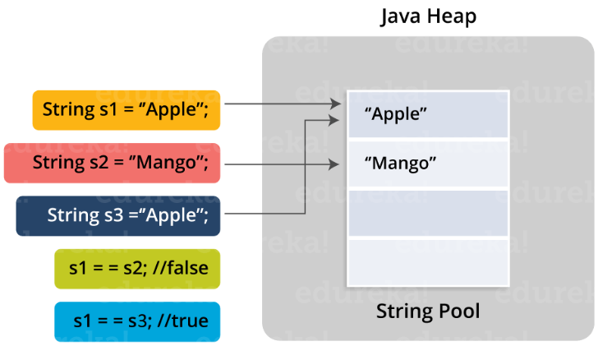
Create a String object
Java String Pool: Java String pool refers to collection of Strings which are stored in heap memory.
In this, whenever a new object is created, String pool first checks whether the object is already present in the pool or not. If it is present, then same reference is returned to the variable else new object will be created in the String pool and the respective reference will be returned. Refer to the diagrammatic representation for better understanding:

Slide 6
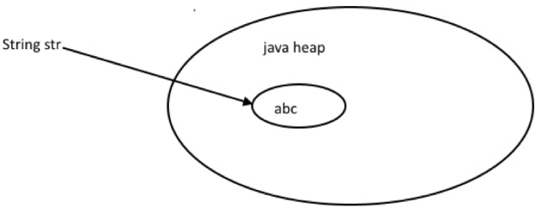
Create a String object
Java reference variable when Using new keyword
We can create String object using new operator, just like any normal java class
String str = new String("abc");

Slide 7
Example
public class StringExample{
  public static void main(String args[]){
    String s1="java";//creating string by java string literal
    char ch[]={'s','t','r','i','n','g','s'};
    String s2=new String(ch);//converting char array to string
    String s3=new String("example");//creating java string by new keyword
    System.out.println(s1);
    System.out.println(s2);
    System.out.println(s3);
  }
}
Output:
java
strings
example

Slide 8
Methods of String
The java.lang.String class provides many useful methods to perform operations on sequence of char values.
No. | Method | Description
1 | char charAt(int index) | returns char value for the particular index
2 | int length() | returns string length
3 | static String format(String format, Object... args) | returns a formatted string.
4 | static String format(Locale l, String format, Object... args) | returns formatted string with given locale.
5 | String substring(int beginIndex) | returns substring for given begin index.
6 | String substring(int beginIndex, int endIndex) | returns substring for given begin index and end index.
7 | boolean contains(CharSequence s) | returns true or false after matching the sequence of char value.

Slide 9
Methods of String
No. | Method | Description
8 | static String join(CharSequence delimiter, CharSequence... elements) | returns a joined string.
9 | static String join(CharSequence delimiter, Iterable<? extends CharSequence> elements) | returns a joined string.
10 | boolean equals(Object another) | checks the equality of string with the given object.
11 | boolean isEmpty() | checks if string is empty.
12 | String concat(String str) | concatenates the specified string.
13 | String replace(char old, char new) | replaces all occurrences of the specified char value.
14 | String replace(CharSequence old, CharSequence new) | replaces all occurrences of the specified CharSequence.
15 | static String equalsIgnoreCase(String another) | compares another string. It doesn't check case.
16 | String[] split(String regex) | returns a split string matching regex.
17 | String[] split(String regex, int limit) | returns a split string matching regex and limit.

Slide 10
Methods of String
No. | Method | Description
19 | int indexOf(int ch) | returns the specified char value index.
20 | int indexOf(int ch, int fromIndex) | returns the specified char value index starting with given index.
21 | int indexOf(String substring) | returns the specified substring index.
22 | int indexOf(String substring, int fromIndex) | returns the specified substring index starting with given index.
23 | String toLowerCase() | returns a string in lowercase.
24 | String toLowerCase(Locale l) | returns a string in lowercase using specified locale.
25 | String toUpperCase() | returns a string in uppercase.
26 | String toUpperCase(Locale l) | returns a string in uppercase using specified locale.
27 | String trim() | removes beginning and ending spaces of this string.
28 | static String valueOf(int value) | converts given type into string. It is an overloaded method.

Slide 11
Java String Methods
char charAt(int index): Returns the character at the specified index. Specified index value should be between '0' to 'length() -1' both inclusive. It throws IndexOutOfBoundsException if index is invalid/ out of range.
  String blogName = "howtodoinjava.com";
  char c = blogName.charAt(5); //'d'
boolean equals(Object obj): Compares the string with the specified string and returns true if both matches else false.
  String blogName = "howtodoinjava.com";
  blogName.equals( "howtodoinjava.com" ); //true
  blogName.equals( "example.com" ); //false
boolean equalsIgnoreCase(String string): Compares same as equals method but in case insensitive way.
  String blogName = "howtodoinjava.com";
  blogName.equalsIgnoreCase( "howtodoinjava.com" ); //true
  blogName.equalsIgnoreCase( "HowToDoInJava.com" ); //true

Slide 12
Java String Methods
int compareTo(String string): Compares the two strings lexicographically based on the Unicode value of each character in the strings.
  return 0 if the argument string is equal to this string;
  return <0 if this string is lexicographically less than the string argument;
  return >0 if this string is lexicographically greater than the string argument.
  String blogName = "howtodoinjava.com";
  blogName.compareTo( "HowToDoInJava.com" ); //32
  blogName.compareTo( "example.com" ); //3
int compareToIgnoreCase(String string): Same as CompareTo method however it ignores the case during comparison.
  String blogName = "howtodoinjava.com";
  blogName.compareToIgnoreCase( "HowToDoInJava.com" ); //0
  blogName.compareToIgnoreCase( "example.com" ); //3

Slide 13
Java String Methods
boolean startsWith(String prefix, int offset) – Checks whether the String is having the specified prefix or not – starting from the specified offset index.
  String blogName = "howtodoinjava.com";
  blogName.startsWith( "d", 5 ); //true
  blogName.startsWith( "e", 5 ); //false
boolean startsWith(String prefix) – Tests whether the string is having specified prefix, if yes then it returns true else false. The offset index value is 0 in this overloaded method.
  String blogName = "howtodoinjava.com";
  blogName.startsWith( "h" ); //true
  blogName.startsWith( "e" ); //false
boolean endsWith(String suffix) – Checks whether the string ends with the specified suffix.
  String blogName = "howtodoinjava.com";
  blogName.endsWith( "com" ); //true
  blogName.endsWith( "java" ); //false

Slide 14
Java String Methods
int indexOf(int ch) – Returns the index of first occurrence of the specified character argument in the string.
  String blogName = "howtodoinjava.com";
  blogName.indexOf( 'o' ); //1
int indexOf(int ch, int fromIndex) – Overloaded version of indexOf(char ch) method however it starts searching in the string from the specified fromIndex.
  String blogName = "howtodoinjava.com";
  blogName.indexOf( 'o', 5 ); //6
int indexOf(String str) – Returns the index of first occurrence of specified substring 'str'.
  String blogName = "howtodoinjava.com";
  blogName.indexOf( "java" ); //9
int indexOf(String str, int fromIndex) – Overloaded version of indexOf(String str) method however it starts searching in the string from the specified fromIndex.
  String blogName = "howtodoinjava.com";
  blogName.indexOf( "java" , 5); //9

Slide 15
Java String Methods
int lastIndexOf(int ch) – Returns the last occurrence of the character 'ch' in the string.
  String blogName = "howtodoinjava.com";
  blogName.lastIndexOf( 'o' ); //15
int lastIndexOf(int ch, int fromIndex) – Overloaded version of lastIndexOf(int ch) method. It starts searching backward starting at the fromIndex.
  String blogName = "howtodoinjava.com";
  blogName.lastIndexOf( 'o', 5 ); //4
int lastIndexOf(String str) – Returns the index of last occurrence of string 'str'. It is similar to lastIndexOf(int ch).
  String blogName = "howtodoinjava.com";
  blogName.lastIndexOf( "java" ); //9
int lastIndexOf(String str, int fromIndex) – Overloaded version of lastIndexOf(String str) method. It starts searching backward starting at the fromIndex.
  String blogName = "howtodoinjava.com";
  blogName.lastIndexOf( "java", 6 ); //9

Slide 16
Java String Methods
String substring(int beginIndex) – Returns the substring of the string. The substring starts with the character at the specified index.
  String blogName = "howtodoinjava.com";
  blogName.substring( 7 ); //injava.com
String substring(int beginIndex, int endIndex) – Returns the substring. The substring starts with character at beginIndex and ends with the character at endIndex.
  String blogName = "howtodoinjava.com";
  blogName.substring( 7, 9 ); //in
String concat(String str) – Concatenates the specified string argument at the end of the string.
  String blogName = "howtodoinjava.com";
  blogName.concat( " Hello Visitor !!" ); //howtodoinjava.com Hello Visitor !!

Slide 17
Java String Methods
String replace(char oldChar, char newChar) – Returns the new updated string after changing all the occurrences of oldChar with the newChar arguments.
  String blogName = "howtodoinjava.com";
  blogName.replace( 'o', 'O' ); //hOwtOdOinjava.cOm
String replace(String target, String replacement) – Returns the new updated string after changing all the occurrences of target with the replacement argument.
  String blogName = "howtodoinjava.com";
  blogName.replace( "com", "COM" ); //howtodoinjava.COM
String replaceFirst(String regex, String replacement) – Replaces the first occurrence of substring that matches the given regular expression argument with the specified replacement string.
  String blogName = "howtodoinjava.com";
  blogName.replaceFirst("how", "HOW"); //HOWtodoinjava.com
String replaceAll(String regex, String replacement) – Replaces all the occurrences of substrings that matches the regular expression argument with the replacement string.

Slide 18
Java String Methods
String[] split(String regex, int limit) – Splits the string and returns the array of sub-strings that matches the given regular expression. 'limit' is a maximum number of elements in array.
  String blogName = "howtodoinjava.com";
  blogName.split("o", 3); //[h, wt, doinjava.com]
String[] split(String regex) – Overload of previous method without any threshold limit.
boolean contains(CharSequence s) – Checks whether the string contains the specified sequence of char values. If yes then it returns true else false. It throws NullPointerException if argument is null.
  String blogName = "howtodoinjava.com";
  blogName.contains( "java" ); //true
  blogName.contains( "python" ); //false

Slide 19
Java String Methods
String toUpperCase(Locale locale) – Converts the string to upper case string using the rules defined by specified locale.
  String blogName = "howtodoinjava.com";
  blogName.toUpperCase( Locale.getDefault() ); //HOWTODOINJAVA.COM
String toUpperCase() – Overloaded version of previous toUpperCase() method with default locale.
String toLowerCase(Locale locale) – Converts the string to lower case string using the rules defined by given locale.
String toLowerCase() – Overloaded version of previous method with default locale.

Slide 20
Java String Methods
boolean isEmpty() – Returns true if the given string has 0 length else returns false.
  String blogName = "howtodoinjava.com";
  blogName.isEmpty(); //false
  "".isEmpty(); //true
static String join() – Joins the given strings using the specified delimiter and returns the concatenated Java String literal.
  String.join("-", "how","to", "do", "in", "java") //how-to-do-in-java
String trim() – Removes leading and trailing white spaces from the Java string.
char[] toCharArray() – Converts the string to a character array.
static String copyValueOf(char[] data) – Returns a string that contains the characters of the specified character array.
  char[] chars = new char[] {'h','o','w'};
  String.copyValueOf(chars); //how

Slide 21
References
https://www.geeksforgeeks.org/strings-in-java/
https://www.w3schools.com/java/java_strings.asp
https://www.javatpoint.com/java-string
https://www.edureka.co/blog/java-string/
https://www.journaldev.com/16928/java-string
https://howtodoinjava.com/java-string/

Slide 22


